Slide 1
GAME: Listen the dates and write

Slide 5
January/ˈdʒæn.jʊ ə .ri/

Slide 6
February /ˈfeb.ru. ə r.i/

Slide 7
March /mɑːtʃ/

Slide 8
April /ˈeɪ.prəl/

Slide 9
May /meɪ/

Slide 10
June /dʒuːn/

Slide 11
July /dʒʊˈlaɪ/

Slide 12
August /ˈɔː.gəst/

Slide 13
September /sepˈtem.bə r /

Slide 14
October /ɒkˈtəʊ.bə r /

Slide 15
November /nə ʊ ˈvem.bə r /

Slide 16
December /dɪˈsem.bə r /

Slide 18
When’s your birthday?
It’s on the twenty eighth of April.

Slide 19
When’s your birthday?
It’s on the thirty first of December.

Slide 20
When’s your birthday?
It’s on the twenty fifth of December.

Slide 21
When’s your birthday?
It’s on the fourteenth
of February.

Slide 22
When’s your birthday?
It’s on the sixteenth
of November.

Slide 23
When’s your birthday?
It’s on the sixth
of May.

Slide 24
When’s your birthday?
It’s on the thirtieth
of September.

Slide 25
When’s your birthday?
It’s on the twelfth
of January.

Slide 26
When’s your birthday?
It’s on the eighth
of March.

Slide 29
3
1
4
2

Slide 30
on the fouth of February.
on the fifth of March.
on the twenty third of June.

Slide 36
Le Quang Thang
4th June
19:00
232 Le Duan, Pleiku
Tran Le Gia Nguyen

Slide 37
1.
7.
2.
8.
3.
9.
4.
10.
5.
11.
12.
6.

Slide 39
January: tháng 1
February: tháng 2
March: tháng 3
April: tháng 4
May: tháng 5
June: tháng 6
July: tháng 7
August: tháng 8
September: tháng 9
October: tháng 10
November: tháng 11
December: tháng 12
- When’s your birthday? Sinh nhật bạn là ngày nào?
- It’s on the second of March. Sinh nhật mình là ngày 2 tháng 3

Slide 40
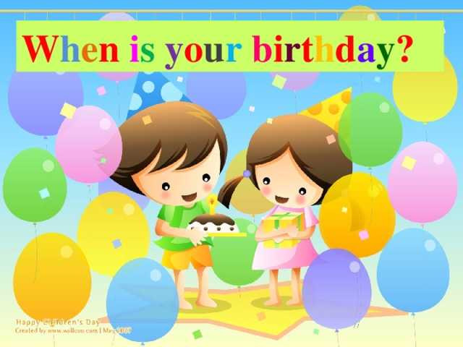
ASK AND ANSWER

Slide 41
Workbook

Slide 42
September
August
sixth
tenth
nineteenth

Slide 43
October
January
When’s
on
twenty-fifth

Slide 46
I. Match
December
March
1 2 3 4
October
May
August
July
5 6 7 8
January
September
9 10 11 12
April
February

